Slide 1
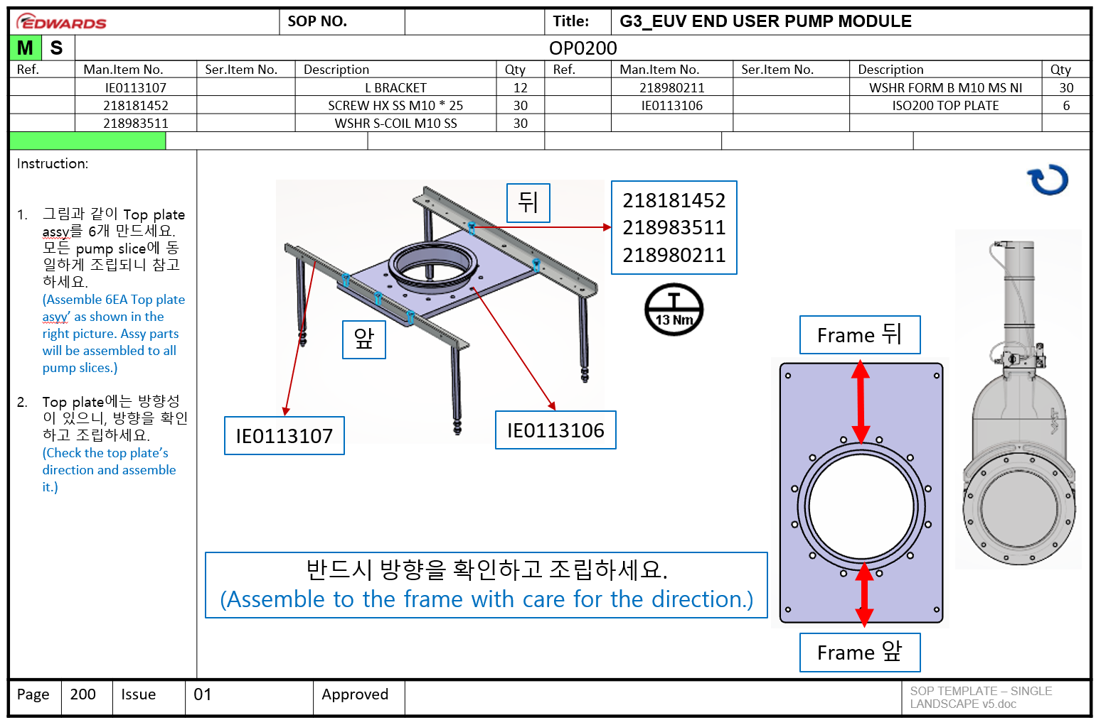
(1,3)
(3,3)
(3,9)
(3,13)
(3,15)
(3,18)
(3,21)
(4,3)
(4,9)
(4,13)
(4,15)
(4,18)
(4,21)
(5,3)
(5,9)
(5,13)
(5,15)
(5,18)
(5,21)

Slide 2
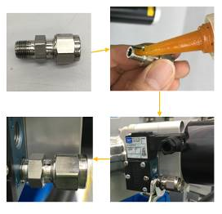






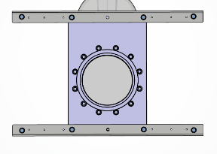


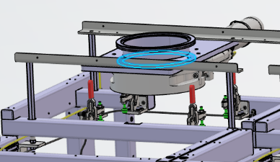


 |  |  |  |  |  |  | c | SOP NO. |  |  |  |  |  | Title: | G3_EUV END USER PUMP MODULE
M | S |  | OP0220
Ref. |  |  | Man.Item No. |  |  |  | Ser.Item No. |  | Description | Description |  | Qty | Qty | Ref. | Man.Item No. |  | Ser.Item No. | Description | Description |  | Qty
 |  |  | IE0113304 |  |  |  |  |  | ISO200 GATE VALVE VAT | ISO250-200 MANIFOLD TEE |  |  | 6 |  | 218983511 |  |  | WSHR S-COIL M10 SS |  |  | 72
 |  |  | B27158081 |  |  |  |  |  | ISO200 TRAPPED O RING VITON | ISO250 TRAPPED O-RING VITON |  |  | 6 |  | 218981311 |  |  | WSHR NORMAL SS M10 |  |  | 72
 |  |  | 218072454 |  |  |  |  |  | SCREW M10*35 HEX HD MS CP | ISO250 TRAPPED O-RING VITON |  |  | 72 |  | IE0123165 |  |  | MALE CONN 6MM TUBE 1/8 BSPT |  |  | 6
Instruction: MALE CONN (IE0123165)에 Loctite 577을 도포한 뒤, 게이트 벨브 “IN” hole에 조립하세요. (Apply the Loctite 577 to the MALE CONN (IE0123165) and assemble it to the gate valve “IN’ hole.) 게이트 벨브를 그림과 같이 조립하세요. 앞, 뒤 방향성이 있으니 확인하세요. (Check the gate valve direction and assemble it.) 게이트 벨브와 Top plate 사이에 오링을 반드시 삽입한 뒤 조립하세요. (Insert the O ring between gate valve and top plate.)
Page |  | 220 |  | Issue |  | 01 |  |  |  | Approved |  |  |  |  |  |  |  |  | SOP TEMPLATE – SINGLE LANDSCAPE v5.doc
(1,3)
(3,3)
(3,9)
(3,13)
(3,15)
(3,18)
(3,21)
(4,3)
(4,9)
(4,13)
(4,15)
(4,18)
(4,21)
(5,3)
(5,9)
(5,13)
(5,15)
(5,18)
(5,21)
12
1
3
5
IE0123165
10
7
8
9
6
11
4
2
위
B27158081
아래
반드시 방향을 확인하고 조립하세요. Assemble to the frame with care for the direction.
Copyright © Edwards Group plc 2020
Company Confidential Document. This document can only be shared with 3rd parties with the written permission of the legal department or if an NDA is in place. If printed this document should be shredded when disposed of.

Slide 3
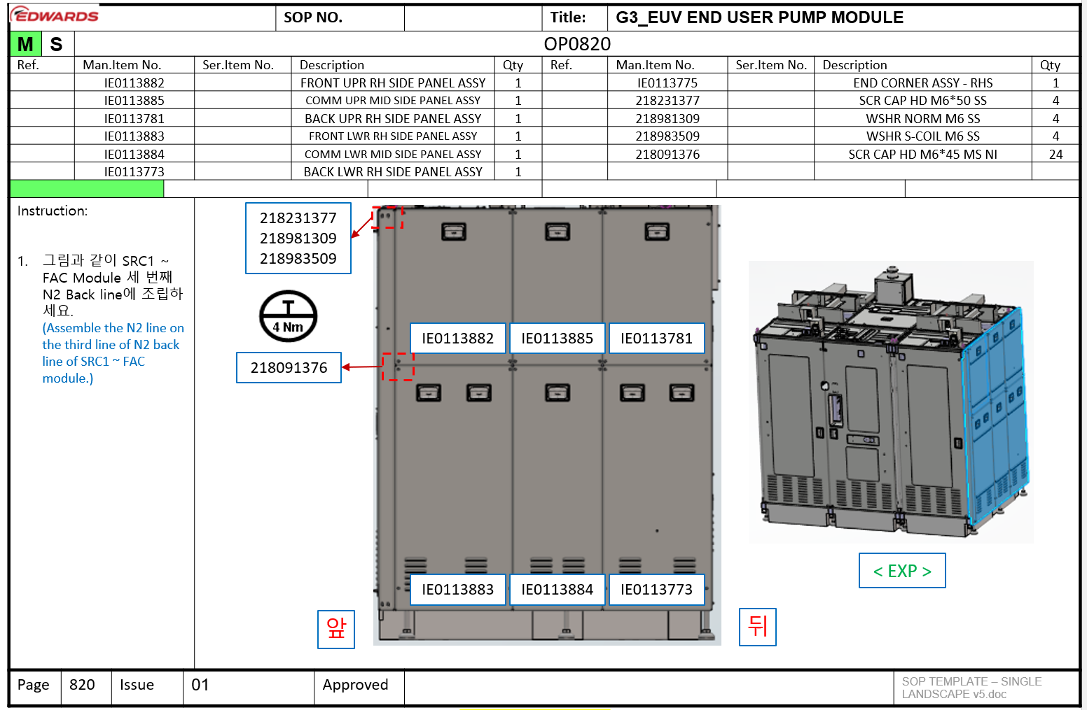
(1,3)
(3,3)
(3,9)
(3,15)
(3,18)
(3,21)
(4,3)
(4,9)
(4,15)
(4,18)
(4,21)
(5,3)
(5,9)
(5,15)
(5,18)
(5,21)
(6,3)
(6,9)
(6,15)
(6,18)
(6,21)
(7,3)
(7,9)
(7,15)
(7,18)
(7,21)
(8,3)
(9,9)
(8,15)
(8,18)
(8,21)

Slide 4
 |  |  |  |  |  |  | c | SOP NO. |  |  |  |  |  | Title: | G3_EUV END USER PUMP MODULE
M | S |  | OP0220
Ref. |  |  | Man.Item No. |  |  |  | Ser.Item No. |  | Description | Description |  | Qty | Qty | Ref. | Man.Item No. |  | Ser.Item No. | Description | Description |  | Qty
 |  |  | IE0113304 |  |  |  |  |  | ISO200 GATE VALVE VAT | ISO250-200 MANIFOLD TEE |  |  | 6 |  | 218983511 |  |  | WSHR S-COIL M10 SS |  |  | 72
 |  |  | B27158081 |  |  |  |  |  | ISO200 TRAPPED O RING VITON | ISO250 TRAPPED O-RING VITON |  |  | 6 |  | 218981311 |  |  | WSHR NORMAL SS M10 |  |  | 72
 |  |  | 218072454 |  |  |  |  |  | SCREW M10*35 HEX HD MS CP | ISO250 TRAPPED O-RING VITON |  |  | 72 |  | IE0123165 |  |  | MALE CONN 6MM TUBE 1/8 BSPT |  |  | 6
Instruction: MALE CONN (IE0123165)에 Loctite 577을 도포한 뒤, 게이트 벨브 “IN” hole에 조립하세요. (Apply the Loctite 577 to the MALE CONN (IE0123165) and assemble it to the gate valve “IN’ hole.) 게이트 벨브를 그림과 같이 조립하세요. 앞, 뒤 방향성이 있으니 확인하세요. (Check the gate valve direction and assemble it.) 게이트 벨브와 Top plate 사이에 오링을 반드시 삽입한 뒤 조립하세요. (Insert the O ring between gate valve and top plate.)
Page |  | 220 |  | Issue |  | 01 |  |  |  | Approved |  |  |  |  |  |  |  |  | SOP TEMPLATE – SINGLE LANDSCAPE v5.doc

Slide 5
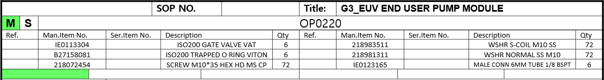
0
3
1
4
2
5
0
6
1
7
2
8
3
9
4
10
5
11

